Slide 1

Video Games Sales Prediction

Slide 2
Introduction
This project describes video game sales around the world and what games are most popular, we learn about the most powerful video games, and game developers across emerging economies are constantly striving to enhance the player experience, release and rewrite it.
Various console/platforms, such as PlayStation, Xbox and Windows PC, which are combined into a single product that is provided to players through the cloud platform. The world is currently going through a horrific and unprecedented event: the COVID-19 pandemic. During these trying times, games have become a way to escape and fill time for many.
I used machine learning models (linear regression model) to predict the sales .

Slide 3
Datasets Description:
This dataset contains a list of video games with sales greater than 100,000 copies.
It was generated by a scrape of vgchartz.com
Rank - Ranking of overall sales
Name - The games name
Platform - Platform of the games release (i.e. PC,PS4, etc.)
Year - Year of the game's release
Genre - Genre of the game
Publisher - Publisher of the game

Slide 4
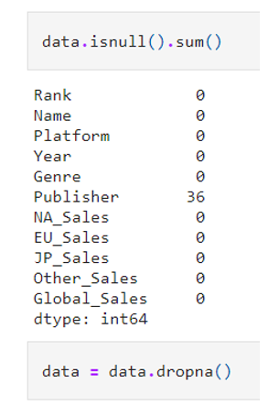
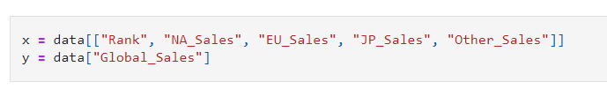
Data Preprocessing
Checking for missing values and dropping them
Defining parameters for ML prediction algorithm

Slide 5
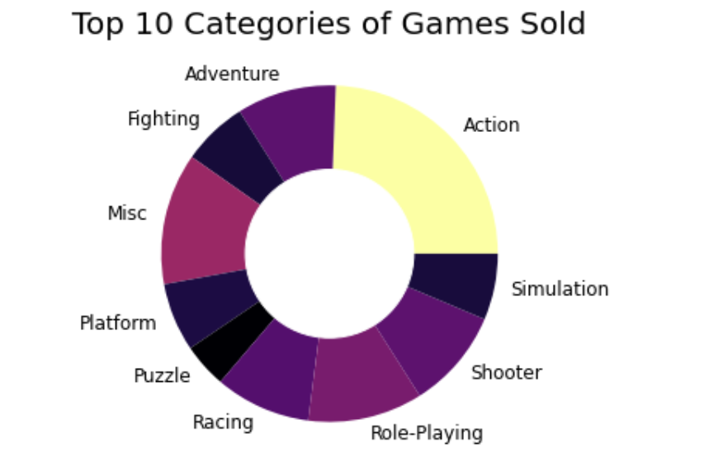
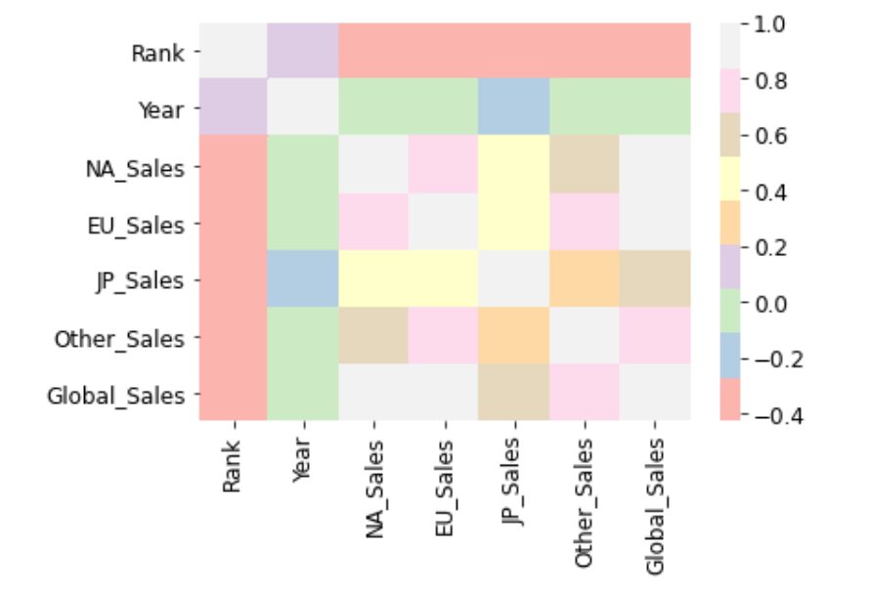
Data Analysis and Visualization
Checking the most games categories were sold
Plotting correlation matrix between features in the datasets

Slide 6
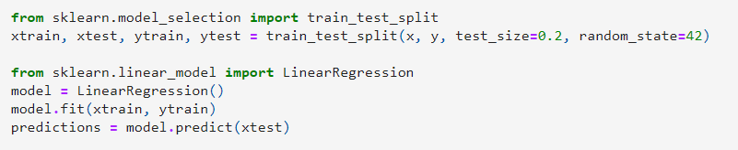
Machine learning Model
Splitting data for training and testing
Building machine learning model (linear regression)

Slide 7
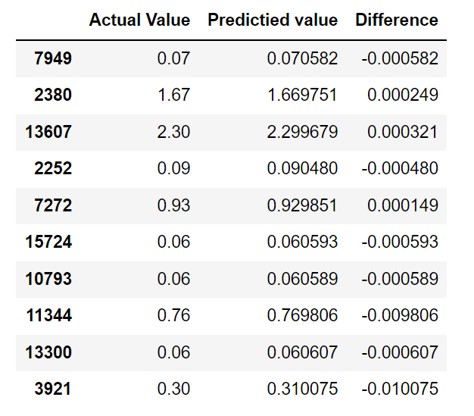
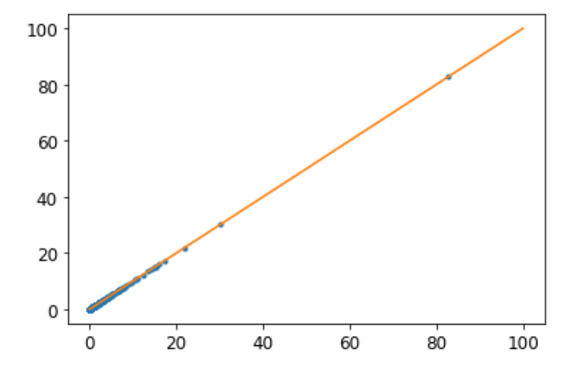
Predictions of the Model

Slide 8
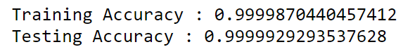
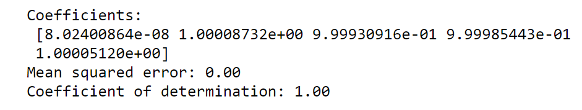
Cross Validation

Slide 9
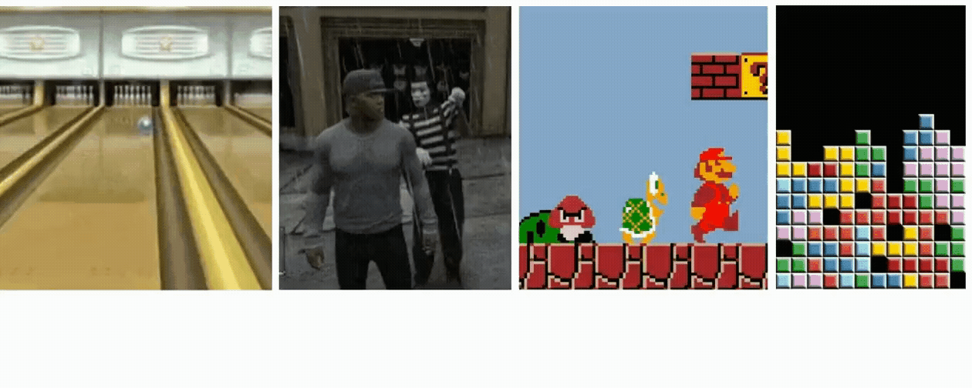
Thanks

